Slide 1
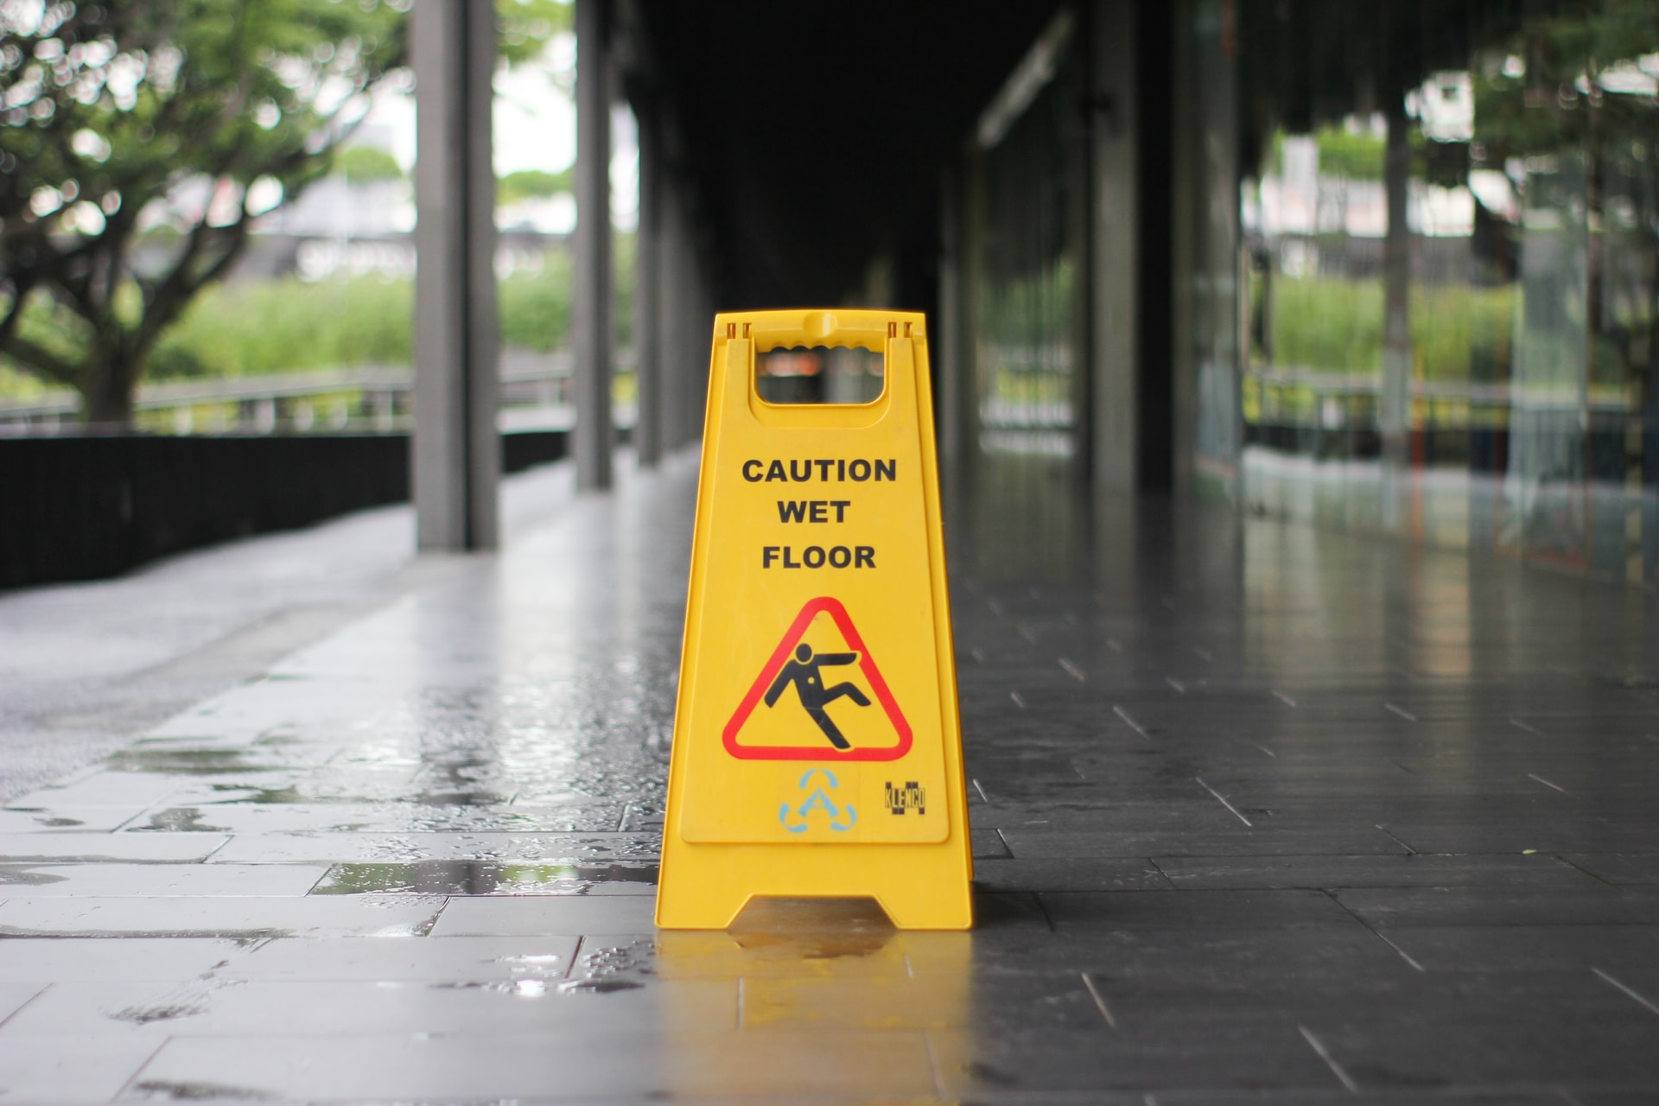

Risk Management: Example of the Risk Process

Slide 2
Example: Risk Management & WHS

Slide 3


Why WHS as an example
Working in ICT
WHS is classed as a common category of risk, that is often assessed by every organisation on some level
Most WHS risks are straight-forward to identify, relatively easy to estimate their severity and likelihood and controls for WHS risks are often well researched and documented. Compare these examples with more complex areas such as financial risks
Work Health Safety requires minimum level compliance for organisations and is enforced by both federal and state legislative frameworks. For us, main key is to follow Victorian guidelines.
Important: Victorian law states that OH&S duties are owed by duty holders, including employers & employees. For each duty holder, they are required to either establish or take part in standard risk procedures including identifying, assessing and controlling risks.

Slide 4
Risk Identification
Working in ICT
Duty holders are obliged to identify/find all reasonably foreseeable hazards in the workplace & understand the harm they may cause:
This includes instituting methods for allowing for easier identification & tracking of hazards such as inspections, finding & applying readily available information (OH&S guides), surveys of employees & analysing records and data
Common workplace hazards include:
Mechanical
Chemical and biological
Sources of energy
Body stressing / impact hazards
Gravity
Psychological hazards
Example: From the routine inspection, tripping hazards due to poor cord management was found to be an identifiable hazard

Slide 5
Risk Assessment
Working in ICT
Risk assessment is the process of developing knowledge & understanding the hazards / risks so sound decisions can be made on controlling exposure to them:
Duty holders are required to conduct risk assessments to determine possible harm, how harm could occur & likelihood of harm occurring
Duty holders are required to conduct risk assessments when there is uncertainty or lack of understanding in the organisation surrounding the hazard/risk and its harm
KEY: The level of harm will influence decisions about how much effort is needed to control the risks
Example: The tripping hazard could cause mild to moderate injuries (as severe as sprained/broken limbs). However, it was very likely to occur due to the number of previous incidents documented in incident reports. Moreover, nothing had been to deal with the regularly tripping issues (“people laughing it off”)

Slide 6
Risk Treatment (“Controls”)
Working in ICT
Duty holders are required to ensure healthy & safety by controlling risks. Risks must be controlled either :
By eliminating them, so far as reasonably practicable; or
By reducing the risks that remain, where elimination is not reasonably practical
System: Hierarchy of Control
The hierarchy of control is a step-by-step approach to eliminating or reducing risks and it ranks risk controls from the highest level of protection and reliability through to the lowest and least reliable protection
Eliminating risk is the highest level of control, followed by reducing the risk, administrative controls (i.e. training) and lastly, through personal protective equipment (“PPE”).
Example: Whilst tripping could not be eliminated, as people could trip on fixed objects, it was reduced through moving power point areas to be more convenient and through administrative actions such as proper care with power points.

Slide 7
Risk Management Review
Working in ICT
The controls put in place by duty holders must be monitored to ensure they work as planned:
Consistent review of risks and controls in place to ensure that changes in risks or degradation of controls (and they are fixed quickly if faulty), do not expose the business going forward
Regular checks of controls can involve inspections of the workplace, consulting employees, testing and measuring, using available information & analysing records/data
Further, compliance dictates we must conduct mandatory reviews in instances where the risk or hazard changes (such as changing the environment where the risk is housed), the controls do not adequately deal with the hazard or an HSR requests a review on reasonable grounds
Example: Despite prior controls, tripping reports still occurred, just at a reduced rate. An HSR officer initiated further reviews on the controls and it was determined the office an entire re-work, particularly where an employee broke their arm tripping

Slide 8
Appendix of Sources
Working in ICT
For your assessment(s), you may be required to undertake further research. The following direct URL hyperlinks provide context on the areas described under Victorian Law:
Duty Holders
Identifying risks/hazards
Risk controls
Overall risk process (identify, assess & treat)
Risk management systems
NOTE: WorkSafe Victoria sources are preferred to Safe Work Australia, as they only provide Model Laws guidance

